Slide 1
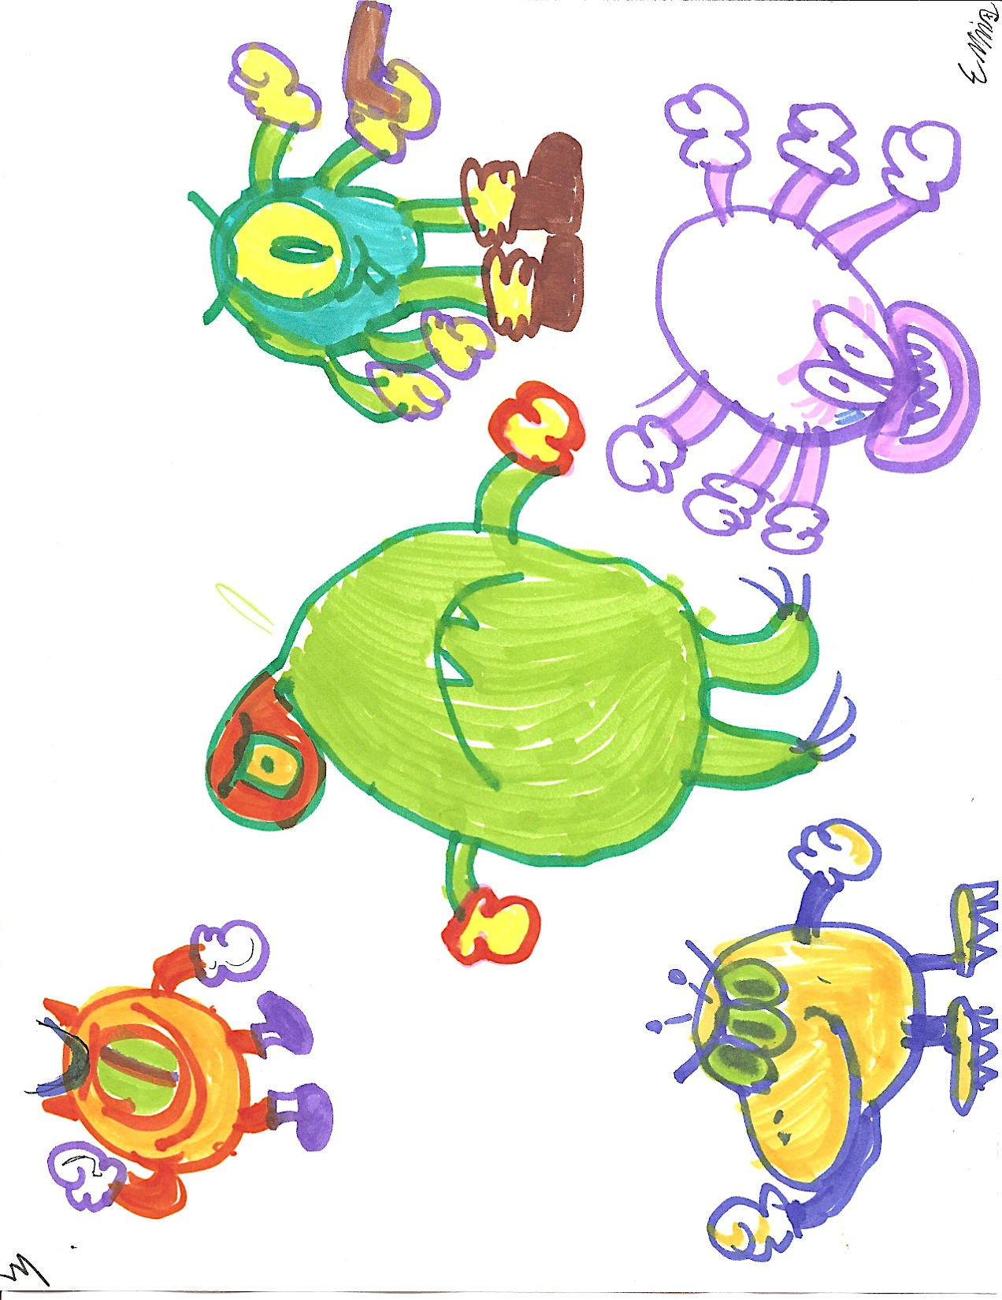
Emerging and Re-Emerging Infectious Diseases - An Overview
EPID 751
Lola V. Stamm, Ph.D.
“Germs” as drawn by Ms. Emma Hall

Slide 2

A Historical Perspective- Some Past Scourges
Humans versus Microbes
Biblical Plagues & Pestilence - Anthrax?
Plague of Athens - 430-426 B.C.E. - Ebola?
Black Death (Plauge of bacterium) - 1347-1350 A.D. – Y. pestis
Age of Discovery- Old & New Worlds Collide
Syphilis - Europe, Asia, Africa (1494-1499)
Smallpox- Aztec & Incan Empires (1520s-1530s)
Measles - Fiji (1875)
Influenza - 1918 Pandemic (What is a pandemic?)
Notes:
Moses’ plagues- one could have been anthrax… lesions, etc.
Y. pestis. Plauge is transmitted normally through rat fleas… if you get normal plague and you breathe it circulates… also the bubonis… if you pop these the bacterium can spread.
Spread of syphilis to Europe… brought back from

Slide 3
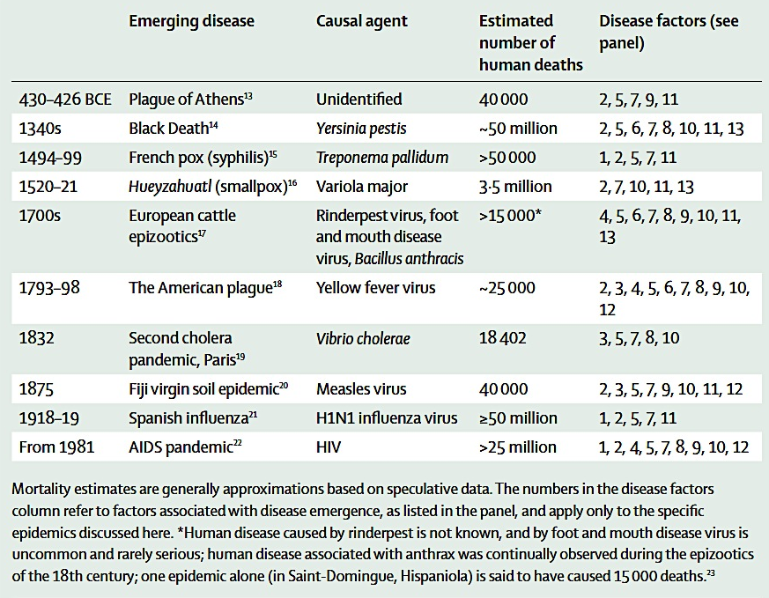
Examples of EIDs of Historical Interest – A little more detail

Slide 4
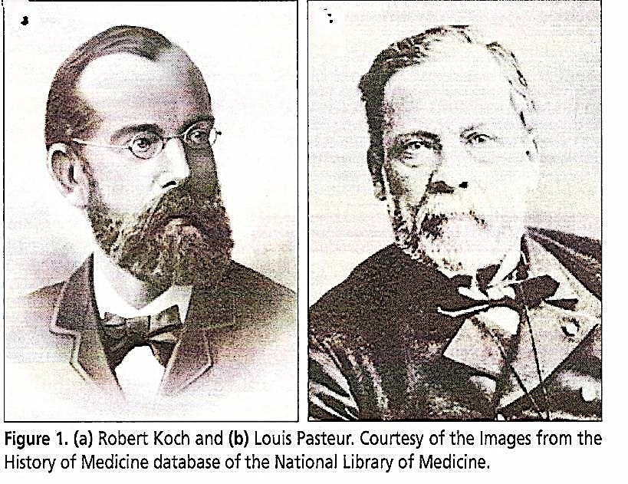
Germ Theory of Disease - Koch & Pasteur
Cause for optimism - Microbes cause IDs!
Great strides
Public Health
Sanitation- Improved food, water, housing
Social and political progress
Epidemiology/Microbiology
Antimicrobials – Ehrlich - Salvarsan
Vaccines – Jenner, Pasteur
Notes:
T. Pallidium is founded in Germany in 1905. Salvarsan is an anrsentical compound discovered to treat syphilis.
Pasteur- rabies vaccines
Jenner- Cholera ?

Slide 5
Koch’s Postulates (As per Loeffler)
The following postulates must be fulfilled to demonstrate the infectious nature of a disease:
The organism must be present consistently in disease tissues
The organism must be isolated and grown in pure culture
The pure culture must be able to induce the same disease in experimental animals
Q: Have Koch’s Postulates been fulfilled for all infectious diseases? No, because some dx only effect certain species (there is no experiemental model for all IDs)
Why??
Notes:
We cannot isolate syphilis in vitro. In the animals models you can infect rabbits but the rabbits don’t have the same symptomomlogy.

Slide 6
1967 - “Time to close the book on infectious diseases”- William H. Stewart, U.S. Surgeon General
But since then:
Only one ID of humans has been eradicated
Two others maybe on the verge, but …?
Polio - 3 serotypes; WPV2 declared eradicated (9/2015); WPV3 (? 2012); WPV1- still with us!
Guinea worm – 3.5 million cases (1986) to 25 cases (2016)
Infectious diseases accounted for ~15-20% of the
56 million deaths in 2012 – but this is likely an
underestimate! Why??
Notes:
Since 1967 we have only eradicated small pox. We have also eradicated some in animals…. Look this up.
Carter foundation- eradication of guinea worm.

Slide 7
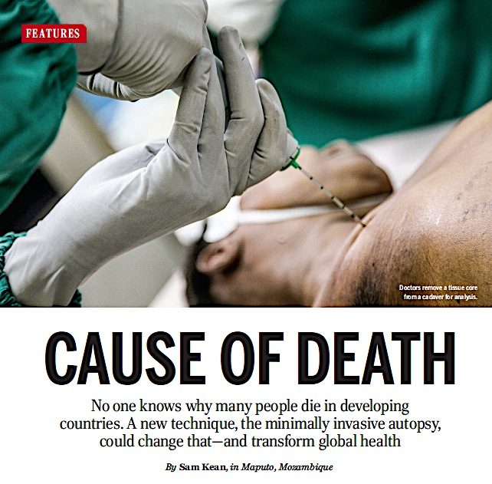
Science (2015) 347: 1410-1413
Notes:
In many countries they do not perform autopsies so we are not always recording the cause of death.

Slide 8
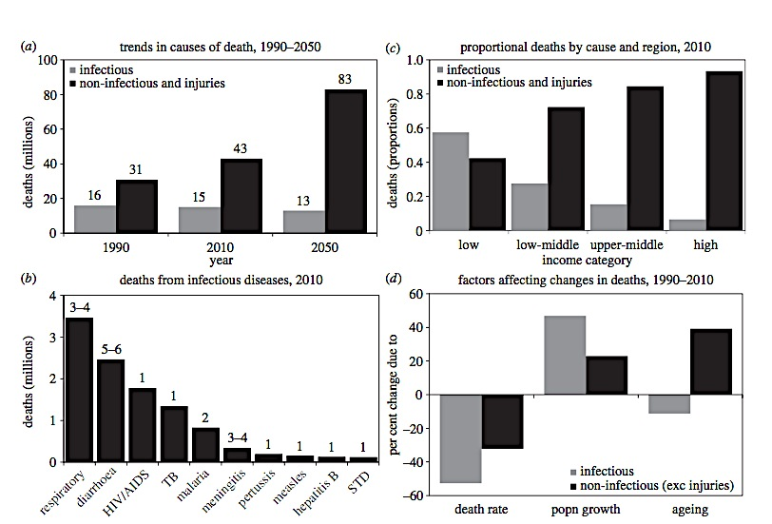
Most deaths due to IDs occur in low & low-middle countries
Dye, C. Philos Trans R Soc Lond B Biol Sci 2014

Slide 9
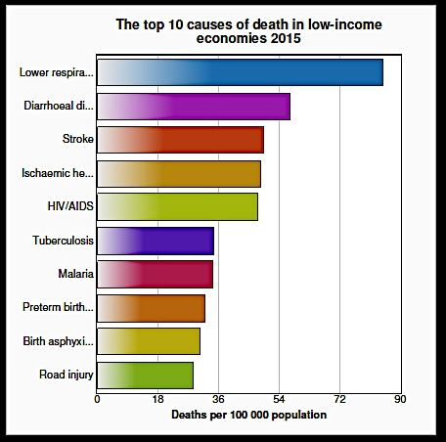
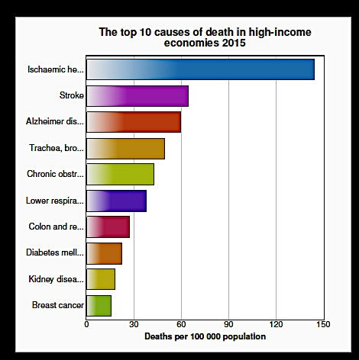
Top 10 Causes of Deaths in Low vs High Income Countries-- 2015
WHO Fact Sheet - 2017
Notes:
TB bacterium
Malaria- parasitic protozoan

Slide 10
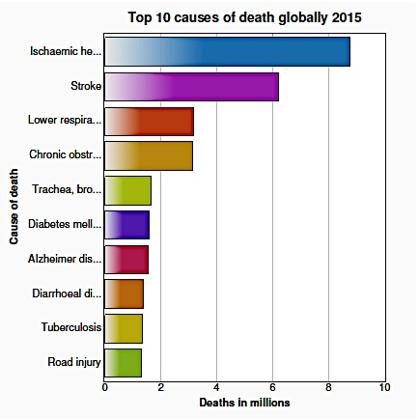
WHO
Fact sheet
2017

Slide 11
Global ID Killers
A handful of infectious diseases claim millions of lives worldwide each year:
lower respiratory tract infections, diarrheal diseases, HIV/AIDS, TB, and
malaria. Together, they accounted for ~ 14% of deaths globally (2015).
Some of these diseases have plagued humankind throughout history, often
decimating populations with greater efficacy than wars.
In an age of vaccines, antibiotics, and scientific progress, these diseases should
have been eliminated. However, they continue to kill at an alarming rate,
particularly affecting children in the developing world.
In low-income countries, the dominant causes of death are infectious diseases
and poor medical care before and after childbirth.
In high-income countries, the leading causes of death are non-communicable
diseases (e.g., heart disease, cancer, diabetes). Infectious causes of mortality
are much farther down the list.

Slide 12
Cancer Chronic Disease
Association ID Agents with Other Conditions
Cervical cancer
HPV *
Stomach cancer
Helicobacter pylori *
Bladder cancer
Schistosoma
Liver cancer
Hepatitis B or C virus *
Kaposi’s sarcoma
Herpesvirus 8 *
Arthritis
B. burgdorferi *
Liver failure, liver disease
Hepatitis B or C virus *
Hemolytic uremic syndrome
E. coli O157:H7 *
Peptic ulcer disease
H. pylori *
Sjogren syndrome
HTLV II *
* = EID
Notes:
T. Cruzi - Chagas’ Disease
Schistosoma spp. – Portal hypertension, liver disease, intestinal granulomatosis
Campylobacter jejuni – Guillain-Barre’ syndrome, reactive arthritis, Reiter syndrome.
Hanta virus – Hypertensive renal disease
HTLV II – T-cell lymphoma, Sjogren syndrome
Epstein-Barr – B-cell lymphoma, Burkitt lymphoma, hairy leukoplakia

Slide 13
1967- Time to close the book on infectious diseases 1999 - “We stand on the brink of a global crisis in infectious diseases. No country can any longer afford to ignore this threat.” Director-General, WHO
What happened?
Do we not have:
Antimicrobials?
Vaccines?
Technology?
What about public health measures?
Notes:
Antimicrobials- antibacterials, antivirals, paracitics

Slide 14
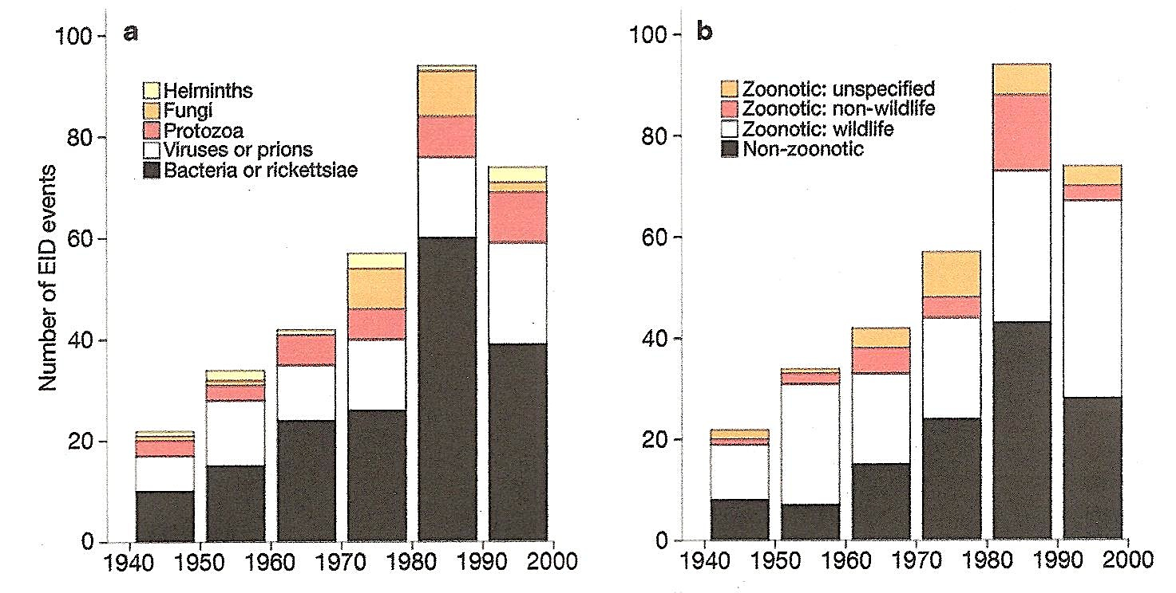
Emerging and Re-Emerging IDs
Definition:
New, re-emerging or drug-resistant infection whose incidence in humans has increased within the past two decades or whose incidence threatens to increase in the near future (IOM)
Alternative Definition:
Emerging IDs are infections resulting from new or newly recognized pathogens (ex. HIV/AIDs, SARS/MERS, Lyme disease, etc.).
Re-emerging IDs are infections due to “classic” pathogens that have resurged (tuberculosis, diphtheria, syphilis, cholera etc.)
Jones, K.E. et al. 2008. Nature 451: 993-993

Slide 15
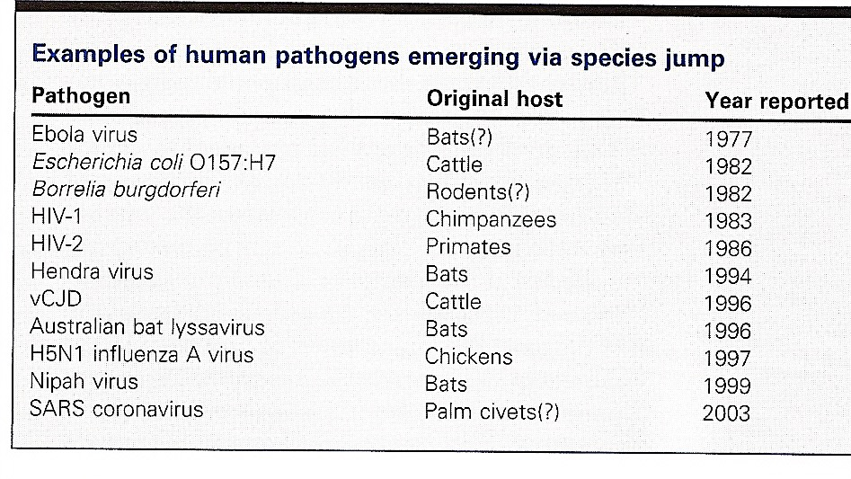
Most Emerging Infectious Diseases are of Zoonotic Origin
MERS
Camels
2012
ZVD
NHP?
?

Slide 16
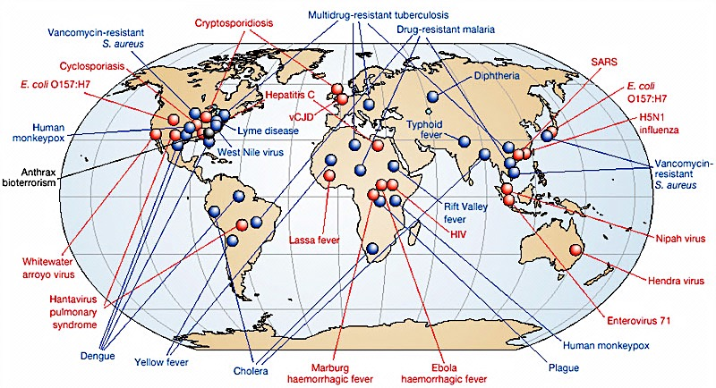
Emerging & Re-emerging IDs – Some examples
Morens, D.M. et al. Nature (2004) 430: 242-249.

Slide 17
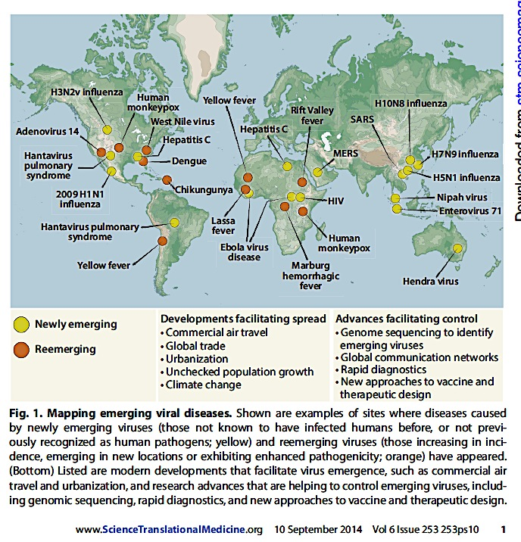
Emerging & Re-emerging Viral Diseases
Note : Zika virus disease was not even “on the radar” in 2014!!
How quickly situations can change

Slide 18
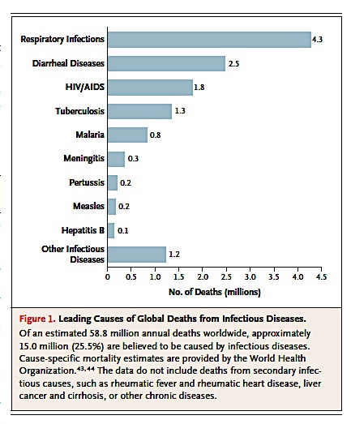
Leading Causes of Death Due to IDs (2015) (How many are due to EIDs/Re-EIDs?)
#1 Lower respiratory infections
#2 Diarrheal diseases
#2 Tuberculosis
#3 HIV/AIDS
36 billion infected globally
#4 Malaria
Fauci & Morens 2012 NEJM

Slide 19
HIV/AIDS – Emerging ID
A leading cause of death worldwide among
adults (age 15-49)
~ 70 million infected; ~35 million deaths
~ 70% infections in sub-Saharan Africa
The number of HIV/AIDs orphans worldwide reached ~17 million in 2016
Any good news??

Slide 20
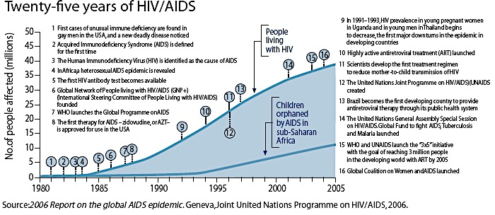
Thirty-seven Years of HIV/AIDS
Virus identified; route(s) of transmission & means to prevent
infection established; diagnostic tests developed; anti-retroviral
combination therapy initiated (treatment = prevention); non-
invasive, rapid self-test FDA approved; vaccine research on-going

Slide 21
Adults and children estimated to be living with HIV - 2014
North America and Western and Central Europe
2.4 million
[1.5 million – 3.5 million]
Eastern Europe & Central Asia
1.5 million
[1.3 million – 1.8 million]
Caribbean
280 000
[210 000 – 340 000]
Middle East & North Africa
240 000
[150 000 – 320 000]
Asia and the Pacific
5.0 million
[4.5 million – 5.6 million]
Latin America
1.7 million
[1.4 million – 2.0 million]
Sub-Saharan Africa
25.8 million
[24.0 million – 28.7 million]
Total: ~37 million
UN AIDS July 2015

Slide 22
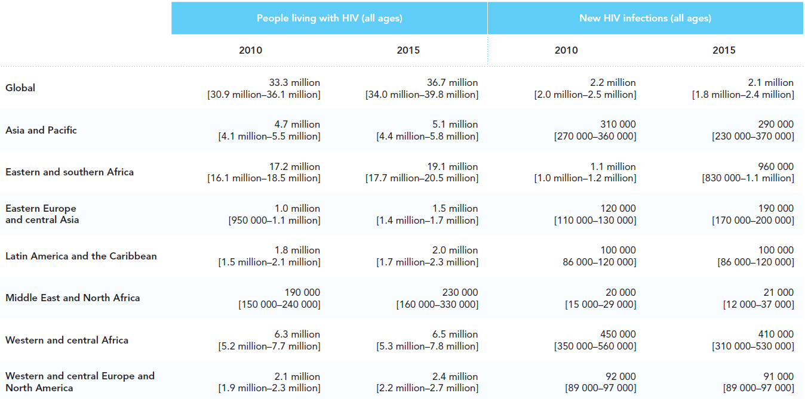
HIV epidemic & response estimates, global & regional 2010 & 2015
People living with HIV (all ages)
New HIV infections (all ages)
Global
Asia and Pacific
Eastern and southern Africa
Eastern Europe
and Central Asia
Latin America
and the Caribbean
Middle East
and North Africa
Western and central Africa
Western and central Europe
and North America
Sources: GARPR 2016; UNAIDS 2016 estimates.

Slide 23
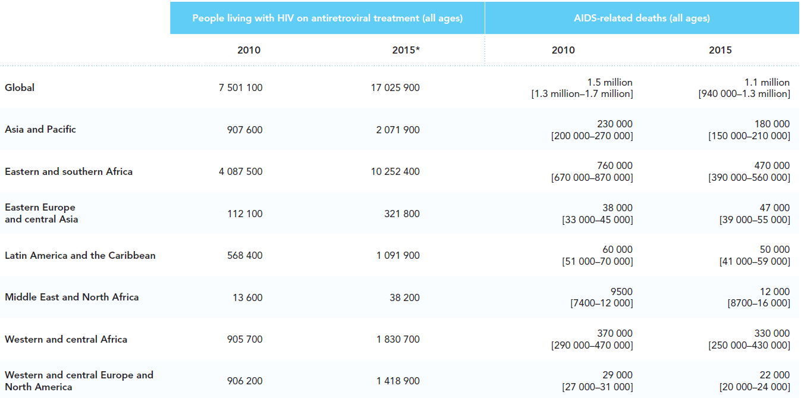
HIV epidemic & response estimates, global & regional 2010 & 2015
People living with HIV
on antiretroviral treatment (all ages)
AIDS-related deaths (all ages)
Global
Asia and Pacific
Eastern and southern Africa
Eastern Europe
and Central Asia
Latin America
and the Caribbean
Middle East
and North Africa
Western and central Africa
Western and central Europe
and North America
* Difference in global and regional sums due to rounding.
Sources: GARPR 2016; UNAIDS 2016 estimates.

Slide 24
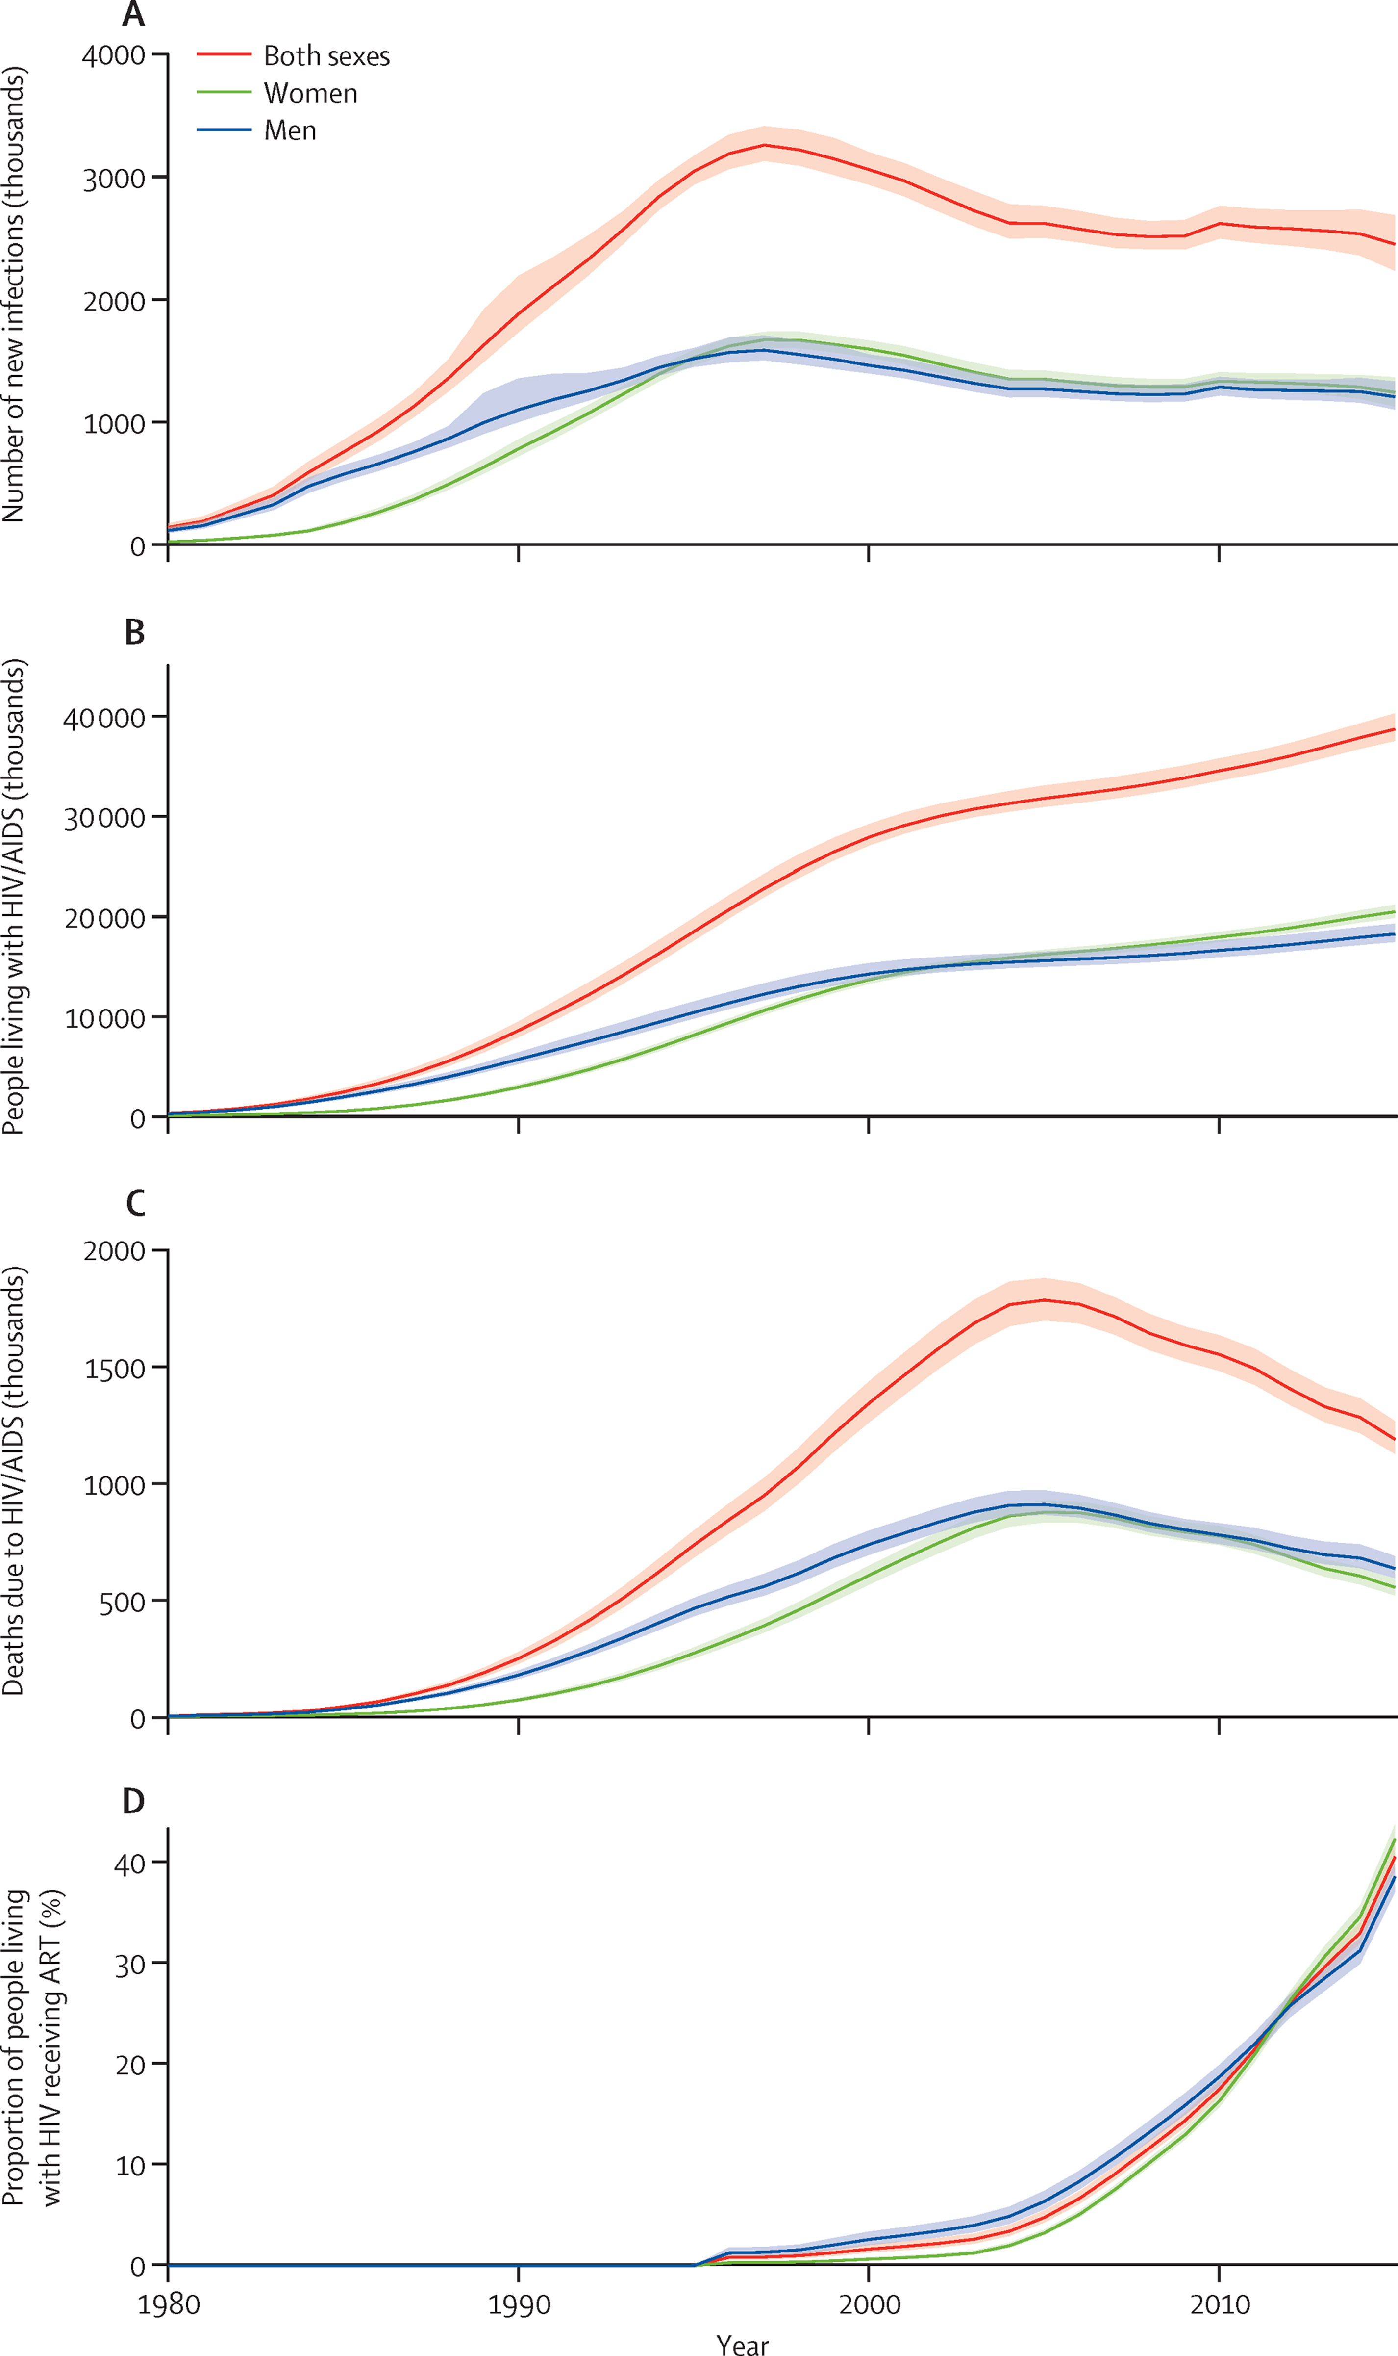
Good News!!
Lancet HIV
7/2016
Wang et al.
New HIV infections
Living with HIV
Deaths due to HIV
Proportion on ART
Global estimates of new HIV infections (A), people living with HIV/AIDS (B), HIV/AIDS deaths (C),
proportion of people living with HIV receiving ART (D). Shaded areas show 95% uncertainty intervals.
Notes:
Evolution of the HIV epidemic from 1980 to 2015
Global estimates of new HIV infections (A), people living with HIV/AIDS (B), HIV/AIDS deaths (C), and proportion of people living with HIV receiving ART (D). Shaded areas show 95% uncertainty intervals. ART=antiretroviral therapy.

Slide 25
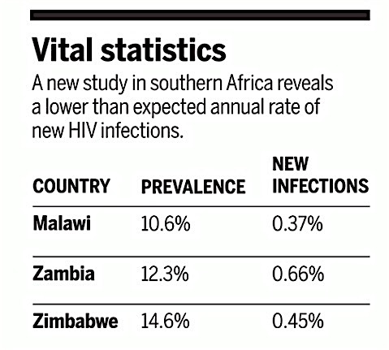
Good News!!
Random household surveys in 3 African countries found >86% of people on treatment had suppressed their HIV, reducing likelihood of HIV transmission. Rates of new infections were lower than predicted by modeling.
Cohen J. 2016 Science 354: 1213

Slide 26
Economic Impact IDs
WHO – World Health Report 2007
Malaria cost Africa >$12 billion/yr in HC costs & lost productivity
Norovirus - $60 billion global economic burden annually
Dengue - ~ $9 billlion global economic burden annually

Slide 27
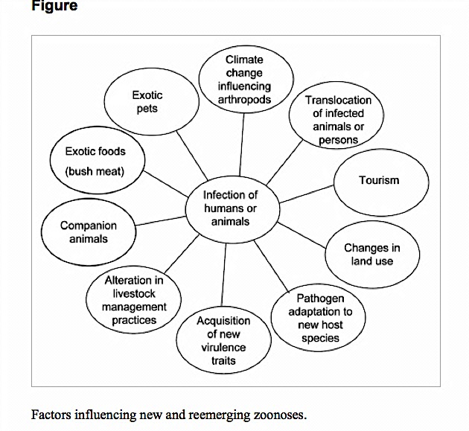
Multiple Factors Drive Emergence/Re-emergence of IDs

Slide 28
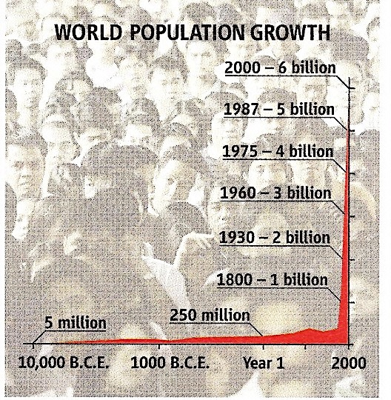
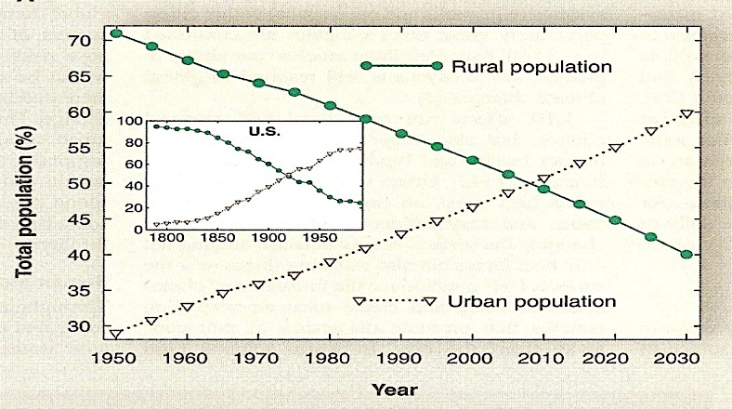
Factors Contributing to Emergence & Re-emergence of Infectious Diseases
Human demographics & behavior
Overpopulation (7.5B)
Overcrowding
Susceptibility
Poverty/inequality
Conflict/War
Migration
Exotic Pets & Animal Reservoirs
Medical “tourism”
Estimated World Population 2045- 9 billion
Note rural to urban transition

Slide 29
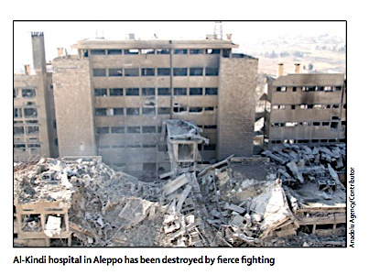
What War Does to Health Care
www.thelancet.com Vol 385 March 14, 2015

Slide 30
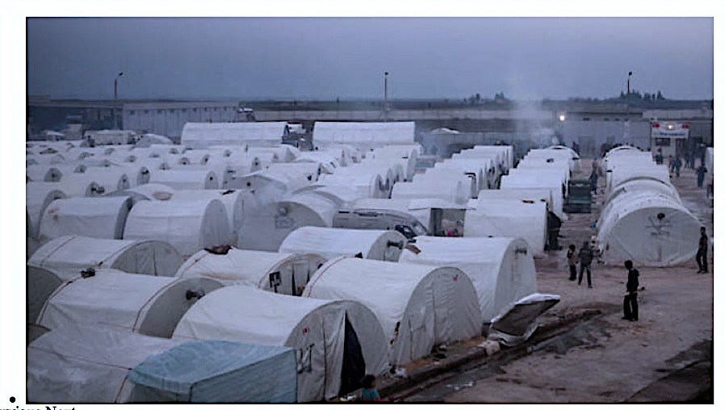
Refugee Camp on Syrian Border
Outbreaks of leishmaniasis have occurred in neighboring countries that
received an influx of Syrian refugees (Lebanon, Jordan, Iraq, Turkey)

Slide 31
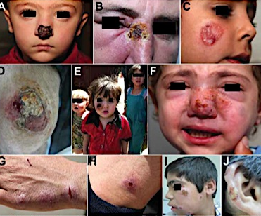
Cutaneous Leishmaniasis in Syrian Refugees
Leishmaniasis is a parasitic infection that is
transmitted by the bite of infected sandflies

Slide 32
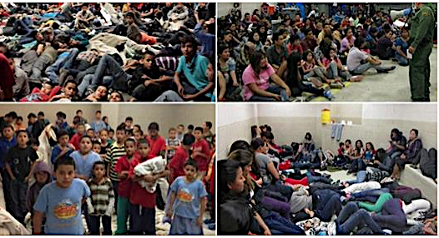
Illegal Immigration and Infectious Diseases?
www.dailymail.co.uk
Rapid influx of unaccompanied minors- U.S.

Slide 33
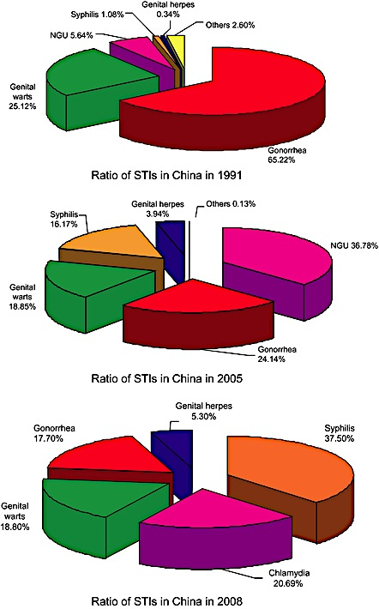
Mass rural to urban “economic” migration has facilitated transmission of STIs in China
BJOG: An International Journal Obstetrics & Gynaecology pages 35-44, 21 OCT 2014 DOI: 10.1111/1471-0528.129
Notes:
Composition of annually reported STIs in China in 1991, 2005 and 2008 (NCSTD: Epidemiologic Reports of Syphilis and Gonorrhea Case Reports in China [www.ncstdc.org]).
© IF THIS IMAGE HAS BEEN PROVIDED BY OR IS OWNED BY A THIRD PARTY, AS INDICATED IN THE CAPTION LINE, THEN FURTHER PERMISSION MAY BE NEEDED BEFORE ANY FURTHER USE. PLEASE CONTACT WILEY'S PERMISSIONS DEPARTMENT ON PERMISSIONS@WILEY.COM OR USE THE RIGHTSLINK SERVICE BY CLICKING ON THE 'REQUEST PERMISSION' LINK ACCOMPANYING THIS ARTICLE. WILEY OR AUTHOR OWNED IMAGES MAY BE USED FOR NON-COMMERCIAL PURPOSES, SUBJECT TO PROPER CITATION OF THE ARTICLE, AUTHOR, AND PUBLISHER.

Slide 34
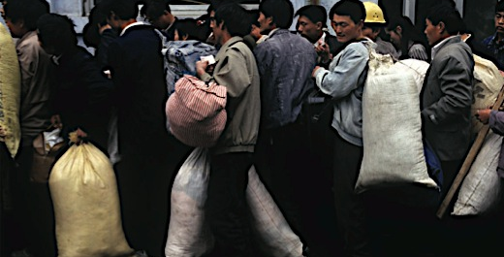
Migrant workers in Bejing waiting for their trains to go back to the country

Slide 35
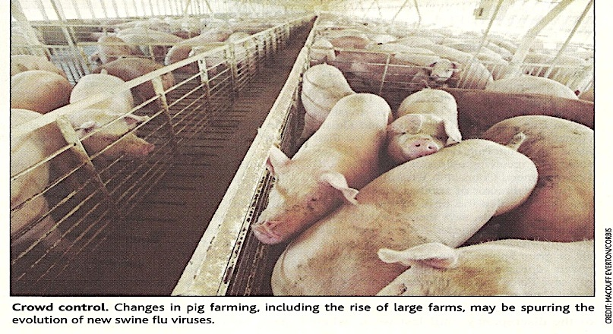
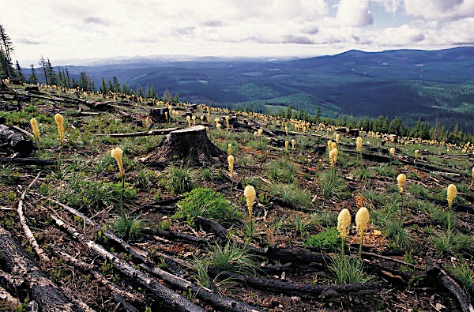

Technology & industry
Economic development & land use
Habitat fragmentation
Ecological & climate change

Slide 36


International travel &
commerce
Breakfast in Hong Kong
Lunch in Cairo
Dinner in New York
It’s a small world,
especially for microbes!
Think: Cholera, MERS, ZVD
Notes:
A lot of stress being placed on ecosystems worldwide.

Slide 37
Today’s world is a global village, with growing concentrations of people in mega cities, mass migrations forced by political and/or economic pressures, and accelerating commerce and travel. An estimated 2.6 million domestic & international airline passengers fly daily, creating routes by which human infections can radiate around the globe within hours. The crates and containers in which goods are shipped worldwide provide safe passage for disease vectors and animal pathogens.
Global Challenges- The National Academies
2016: 75.5 million travelers visited U.S.; >1 Billion people traveled globally

Slide 38
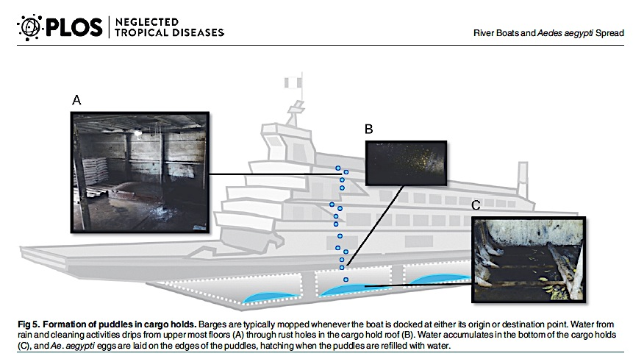
Riverboats can spread IDs by spreading infected mosquitos

Slide 39
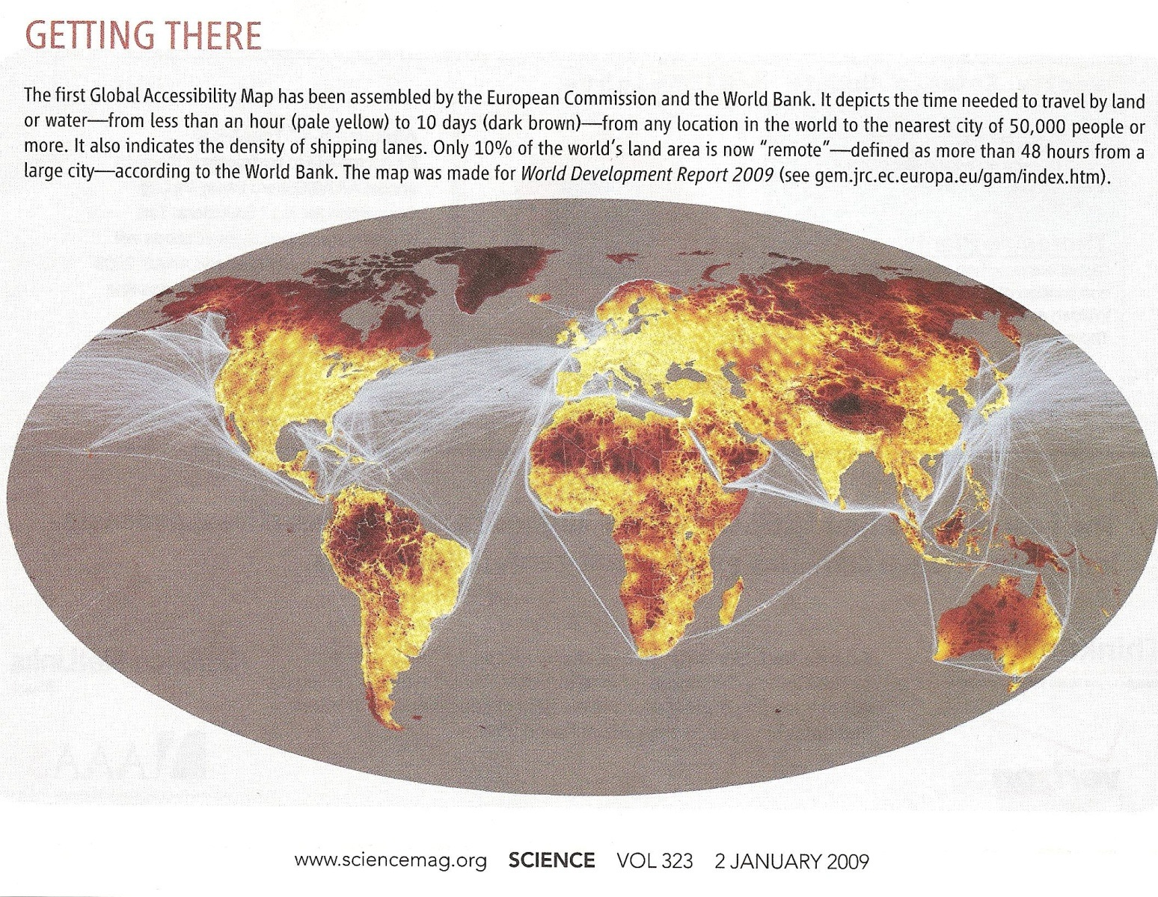
Global Accessibility Map
Only 10% of world’s land area is now “remote”
Remote = >48 hrs from a large city

Slide 40
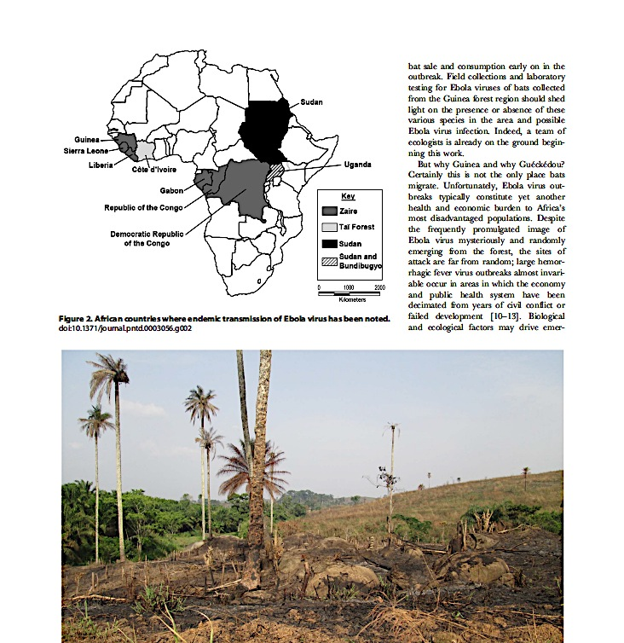
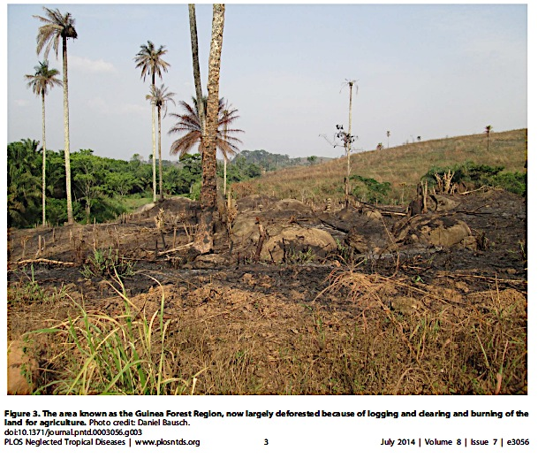
Ebola 2014 Outbreak
~11,300 deaths
“…the Ebola outbreak
poses health risks to
other countries”.
-WHO Emergency
Committee (8/2014)
PLoS Neglected Tropical Diseases Vol. 8(7) July 2014.
Notes:
Forests are being cut down that is forcing bats which transmit EBOLA into the cities and coming into contact more frequently.

Slide 41

Microbial adaptation
& change
Decline of public health infrastructure
Intentional release of pathogens
Bioterrorism-
Anthrax, Salmonella
Accidental release of pathogens – Oops!!
Mutation, gene transfer, re-
combination & reassortment
Smallpox, Anthrax

Slide 42
Are We Losing the “War” with Microbes?
Us
Them
PH Measures
Surveillance
Education
Vaccines
Sanitation
Antimicrobials
Research
Policy – Int’l Cooperation
Modern Medicine
Extreme Adaptability
Mutation
Gene transfer
Recombination
Reassortment
Rapid Replication
Exploit New Niches (Hosts)

Slide 43
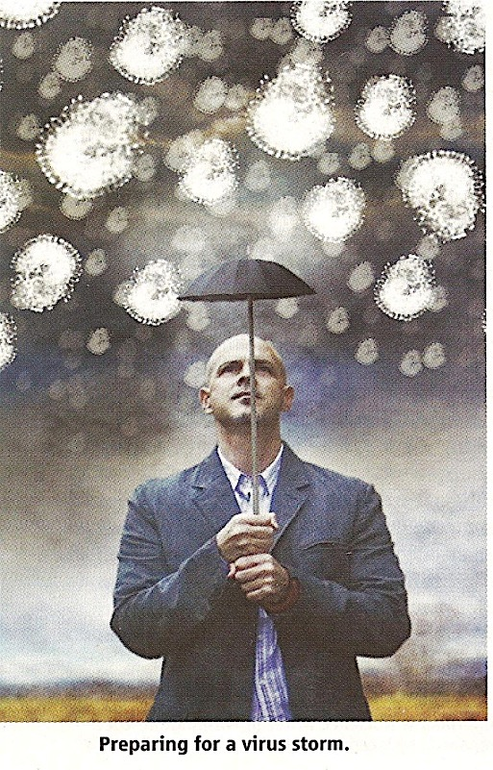
“The future of microbes and mankind will probably unfold as
episodes of a suspense thriller that could be entitled Our wits
versus their genes”
J. Lederberg, Science 2000
Is there cause for optimism??
Scientific co-operation & active surveillance at a worldwide level enabled control of a burgeoning SARS pandemic within eight months - - a remarkable feat!
Thus, given adequate knowledge, resources,
& willpower, efforts to combat EIDs can be successful, but further challenges lie ahead.

Slide 44
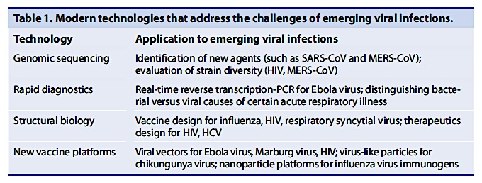
New Technologies to Address EID Challenges

Slide 45
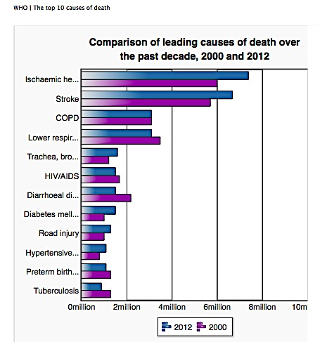
Progress but not perfection!
WHO 2014
Fact sheet
310
*
**
*

Slide 46
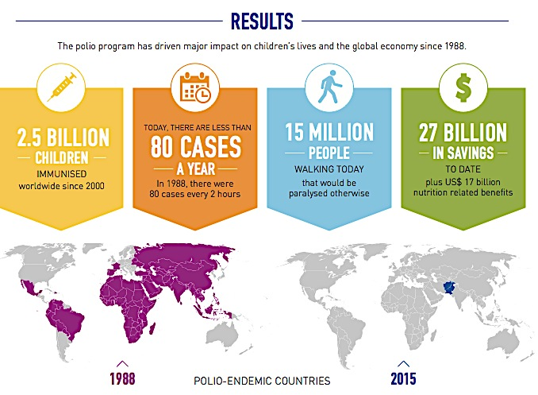
Progress on Polio
But WPV1 has recently been spotted again in Nigeria!!

Slide 47
But don’t get too comfy!
Robert Boyle (1685)- “There are ever new forms of epidemic diseases appearing”
Novel Coronavirus (MERS) Emerges in Middle East (2012)
Cyclospora Outbreak in 19 States Sickens >500 Persons (2013)
Ebola Outbreak in West Africa kills over 11,300 (2014-2015)
South Korea’s Explosive MERS Outbreak (2015)
Legionnaire’s Disease Outbreak Hits New York City (2015)
Zika Virus Disease Outbreak in the Americas (2015-2016)
Dengue Outbreak in Sri Lanka Exceeds 100,000 (2017)
Yemen’s Cholera Outbreak Largest in Recorded History (2017)

Slide 48
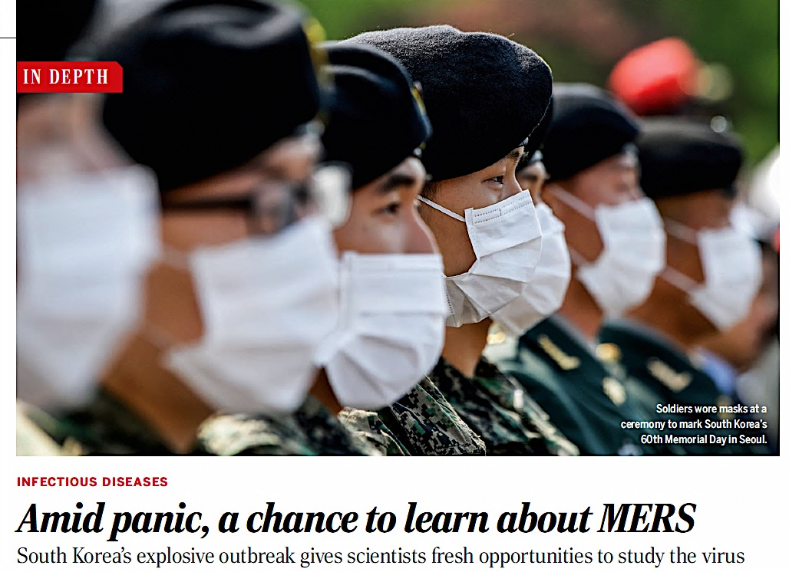
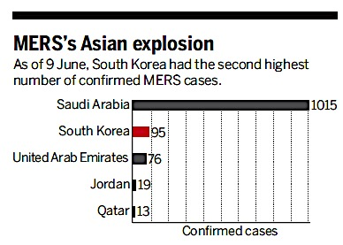
Traveler brings MERS to
South Korea and starts a
superspreading event
Science (2015) 348: 1183-1184

Slide 49
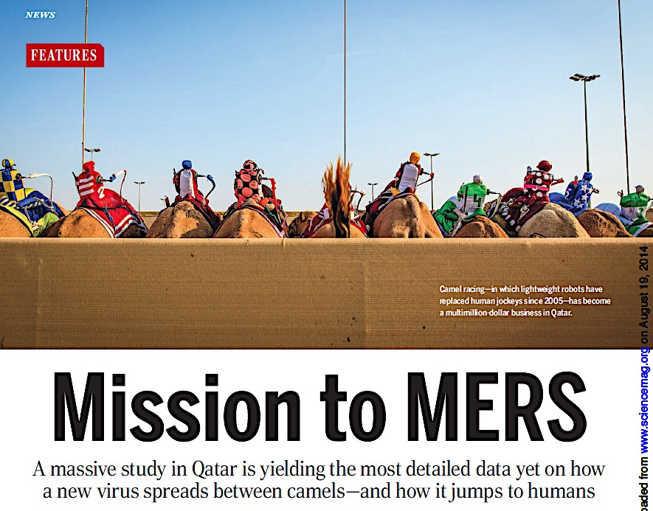
Science (2014) 344: 1218-1220

Slide 50

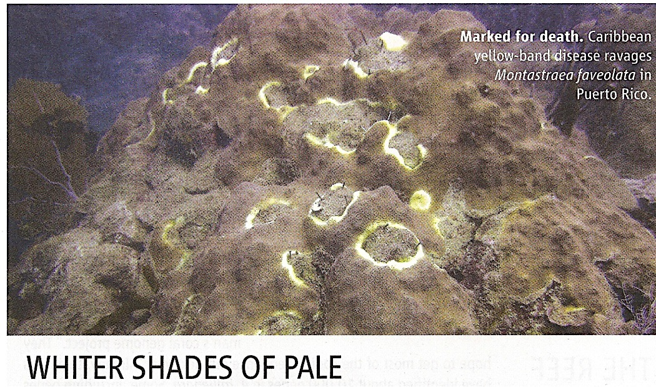
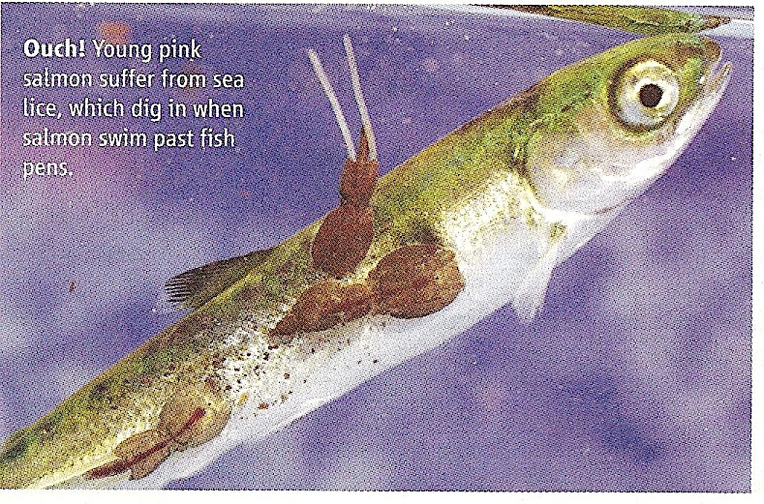

Just a reminder:
Humans Aren’t the Only Species with EID Problems!

Slide 51
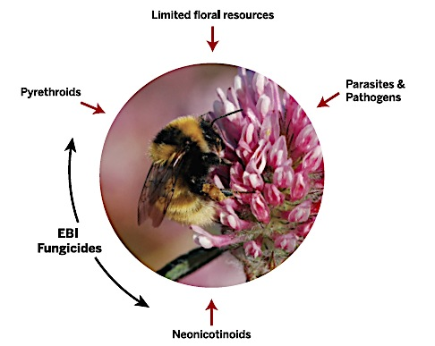
CCD is driven by combined stress from parasites, pesticides, and lack of flowers
Science (2015) 347: 1435
Honeybees are critical to U.S. food supply. 1/3 of our foods are pollinated by
honeybees– which are responsible for >$20 billion worth of U.S. crops per year

Slide 52
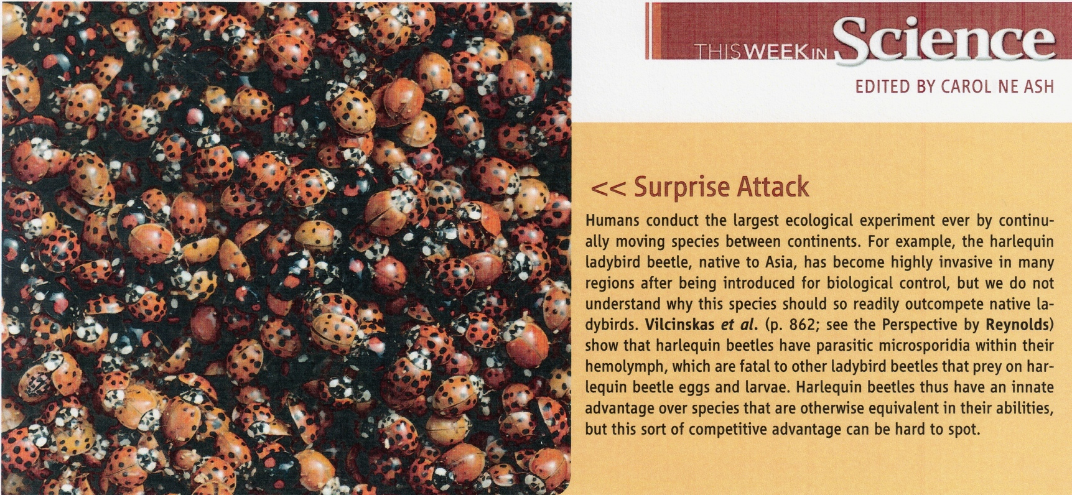
Parasitic microsporidia in Asian ladybugs are fatal to native ladybugs
Science (2013) 340: 785

Slide 53
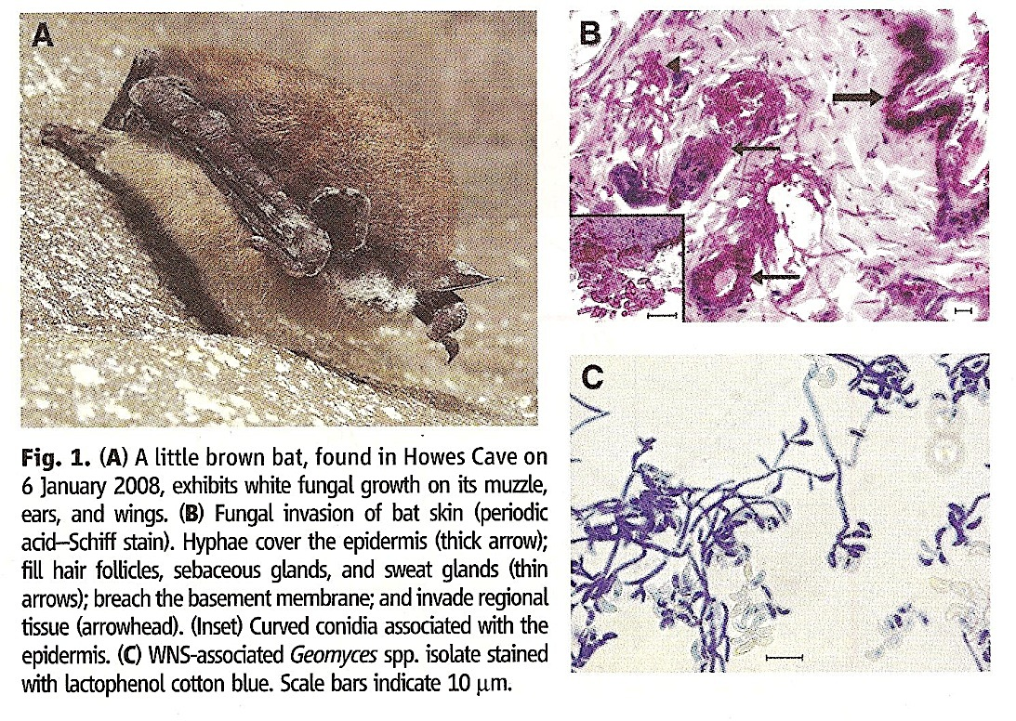
White Nose Syndrome- An Emerging Fungal
Pathogen Devastating U.S. Bats
Millions of bats have died due to WNS
Some colonies have lost 60%-98% of their population

Slide 54
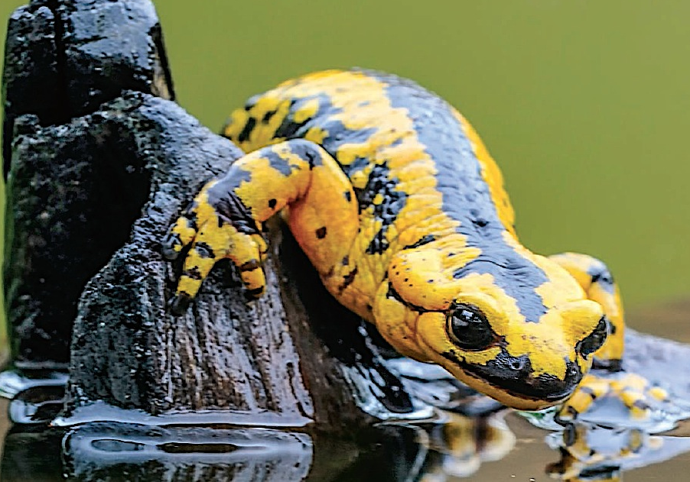
Emerging pathogen (B. salamandrivorans) is driving amphibians to local extinction
Fungal pathogen likely introduced from East Asia to Europe via the pet trade

Slide 55
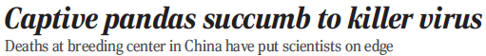
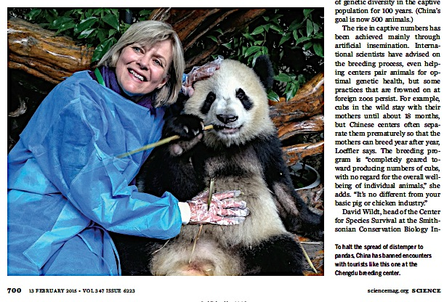
Science (2015) 347: 700
To halt the spread of distemper, China banned encounters
of pandas with tourists.
Notes:
Dsitermper- virus found in dogs and tourists were spreading to pandas

Slide 56
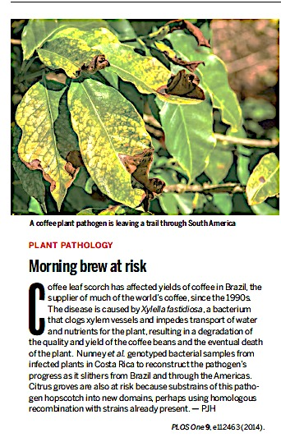
Plants are at risk too– coffee, olives, citrus, almonds

Slide 57
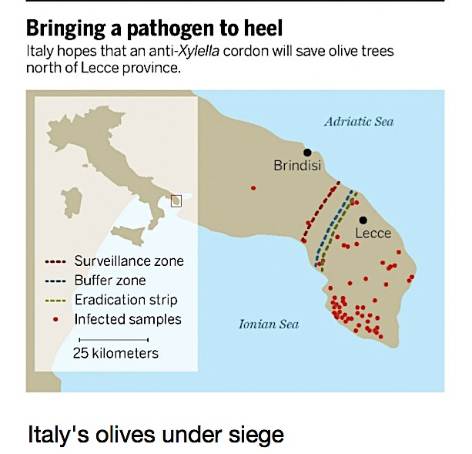
Italy’s Olives Under Siege

Slide 58

Questions??
Morens, DM et al. 2004. Nature 430: 242-249.
Enserink, M. 2010. Science 330: 1736-1739.
Avila, M. et al. 2008. Microbes & Infection 10: 942-947.
Fauci, AS & DM Morens. 2012. N Engl J Med 366: 454-461
Morens, DM & AS Fauci. 2012. mBio 3: e00494-12
Morens, DM & AS Fauci. 2013. PLoS Pathogens 9: e1003467
Brower, J.L. 2015. Microb Ecol
Notes:
Don’t let your pigs kiss your chickens… flu virus.

